Slide 1

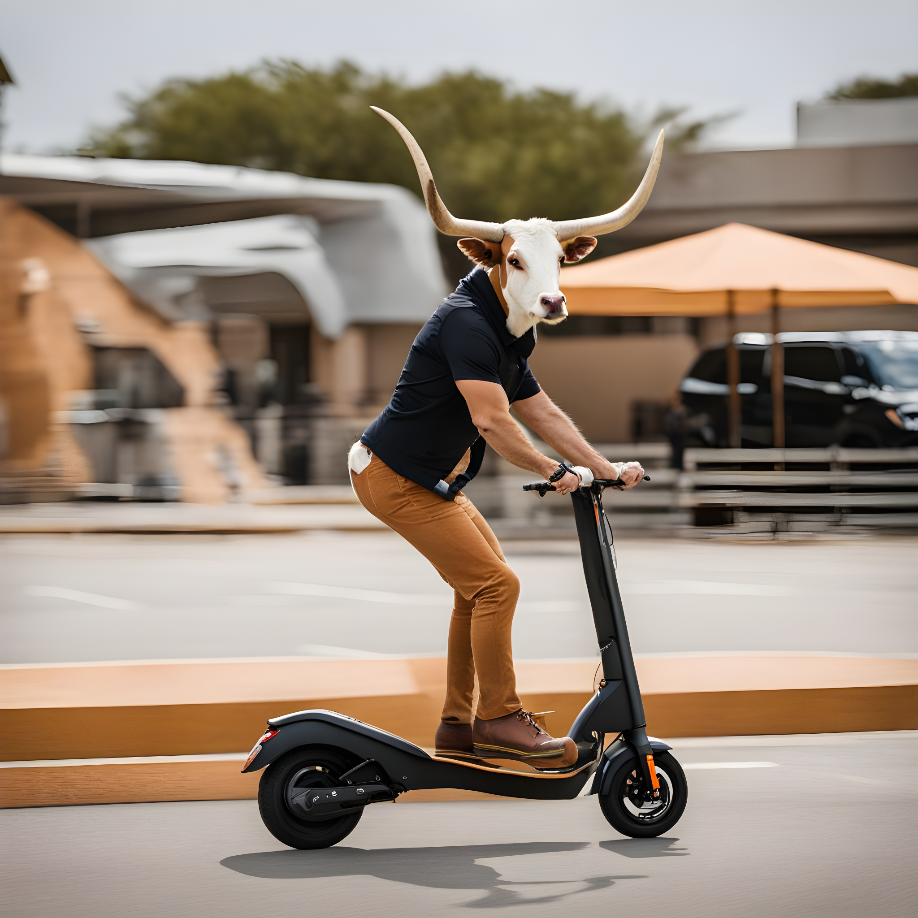

Picking Y ur Electric Ride
By: Sharan Arora, Spandan Pal, Karthick Vel, Manideep Telukuntla, Pritesh Singh, Raghav Vaidya

Slide 2
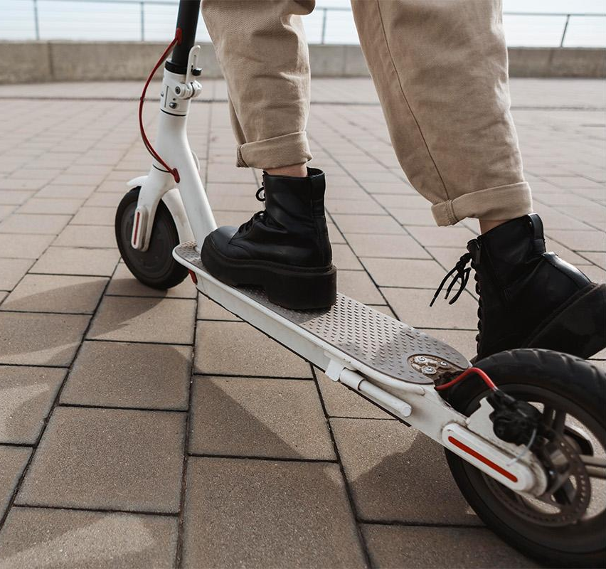
01
Consumers’ Dilemma
Notes:
You’re a college student who stays off campus and want a convenient way to get around to your classes in a 100 degree weather. You like using lime and bird but here are the issues.

Slide 3

Problem Statement - Electric Scooter
Renting electric scooter has gotten more expensive so buying is the way to go
Hundreds of electric scooter products to choose from
But how do we decide which scooter to purchase?
Notes:
Lime and Bird are very expensive to use especially on a frequent basis. So now you want to purchase electric scooters. But which one? There are hundreds of brands and models to choose from. Which one do your purchase?

Slide 4
02
Data
Sources
Notes:
When deciding how to proceed with where we collect data from here is what we did

Slide 5



Data Sources & Preprocessing
Amazon & Youtube
Data Cleaning
Quantify Findings
Notes:
We
Scraped amazon to analyze consumer sentiments and understand what are some of the feature attributes that they look at when potentially making a purchase as well as those that jumped out to them after purchase
YouTube would represent the “critics” and how they found the scooters allowing us to compare and contrast the difference in perception of similar attributes and helping make a recommendation where both critics and consumers align
The combination is what matters as reviewers typically have the unit for ~2 weeks when they review it, but customers provide a deeper insight into long-term issues
The fact that reviewers may have a positive bias and users typically are more incentivised to write when they have a bad experience, the two data source might balance it out
After this we cleaned data for either missing columns and values, dropping certain features and preprocessing our reviews by removing certain words and calibrating others in order to quantify our findings. We shall now delve deeper into those details

Slide 6
03
Analysis
& Results
Notes:
Our analysis is where things become really interesting

Slide 7
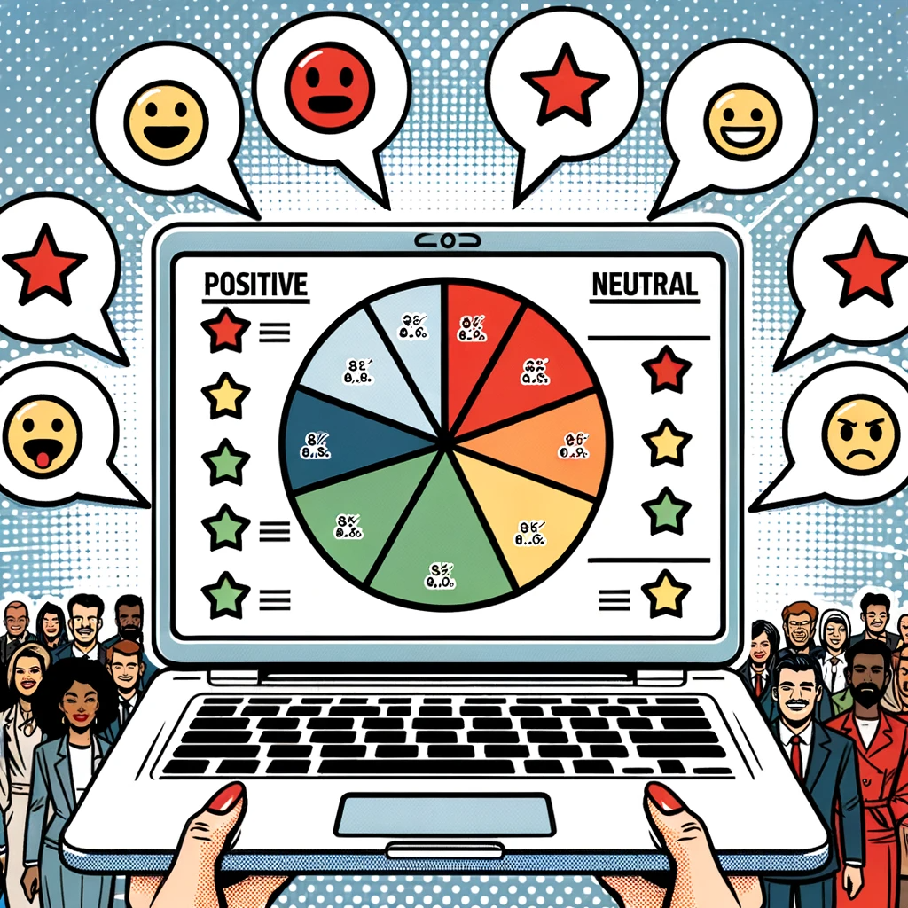
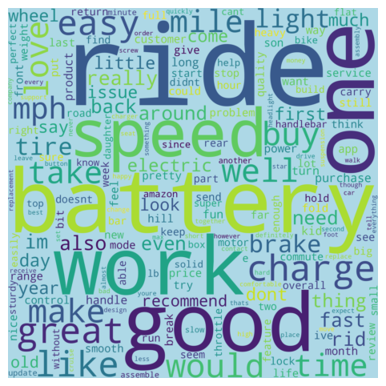
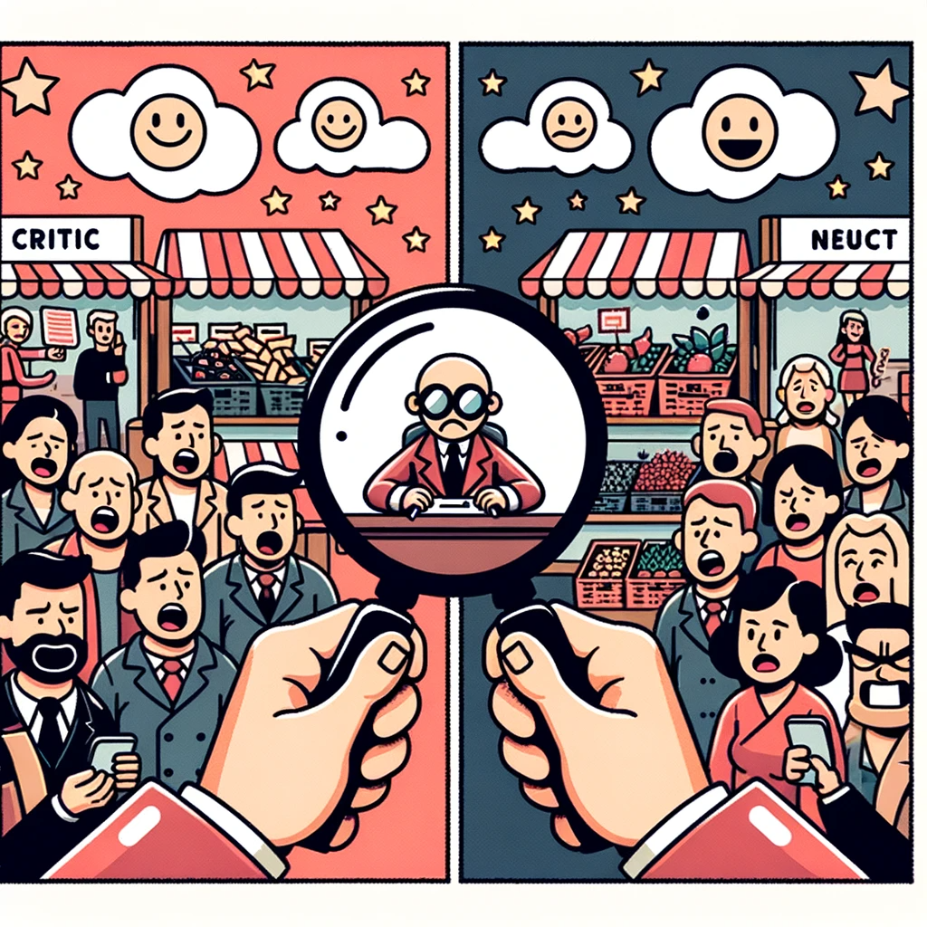
Analysis
Word Frequency Analysis
Similarity Score & Sentiment Analysis
Recommendations and Critic Reviews
Notes:
After cleaning we first performed a word frequency analysis along with POS tagging to identify some of the most common attributes and features discussed in the reviews. Those include
Battery
Power
Speed
Weight
Price
Handlebar
Headlight
Then we proceeded to understand presence of these attributes in our reviews, trying to use bag of words and word vectors/embeddings. Ultimately, we chose to opt for the former because we noticed bag-of-words performance was better. E.g. 🪶 light and 💡 lights were getting conflated in word embeddings.
Finally we proceeded to compare critic sentiments understanding what they consider to be pros and cons as having their insights would also be valuable analysis but also help establish key differences between differing opinions that might exist and where critics and consumers align. After performing said analysis here are our final recommendations and why.
→
© 2023, Sharan

Slide 8
04
Recommendation

Slide 9
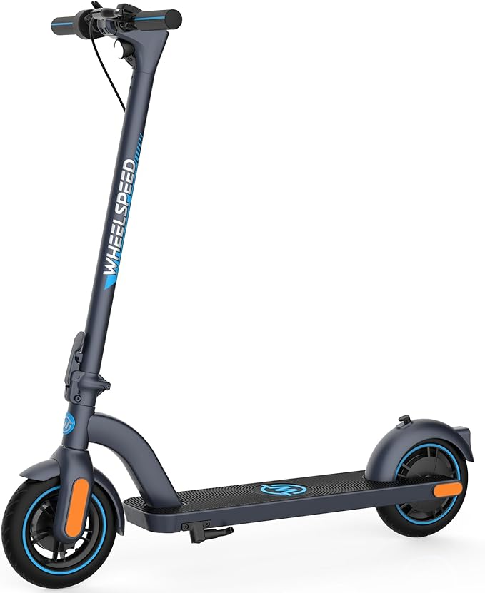
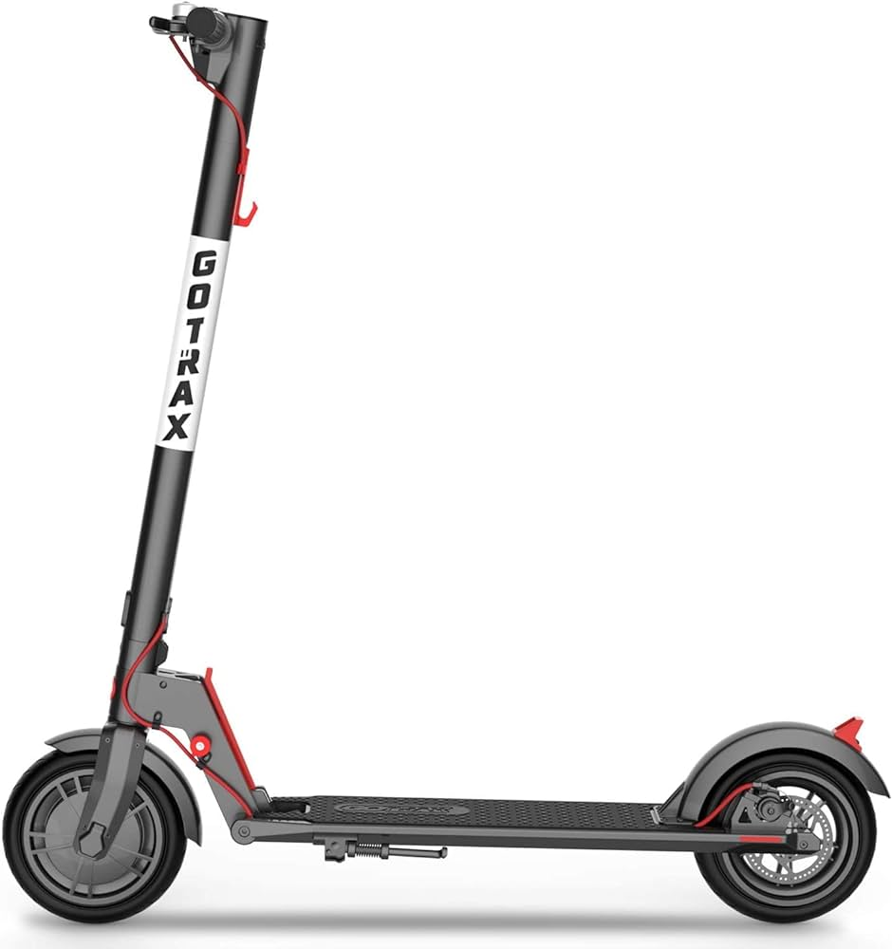
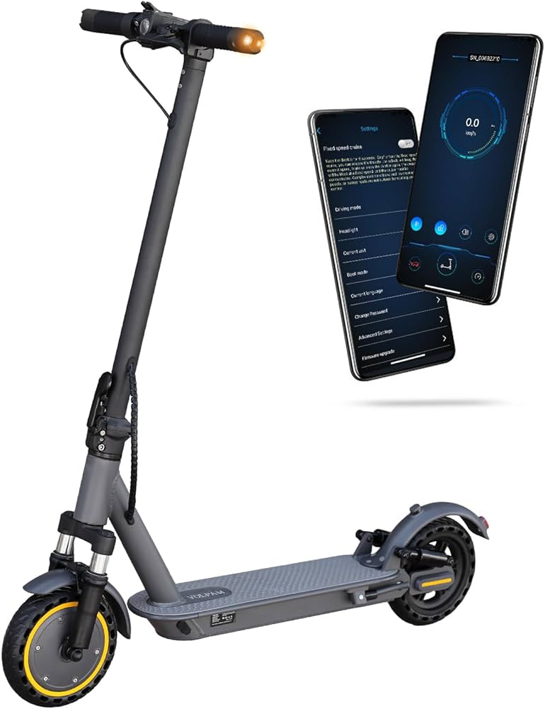
Our Recommendation
Brand | Model | Pros | Cons
Wheelspeed | Primer | User-friendly Reliable speed Cruise control | Weak brakes Password needed
Gotrax | GXL V2 | Lightweight Efficient brakes Great speed | Battery Issues Maintenance Headlight
VOLPAM | SPT7 | Dual shocks Simple assembly Stable | Height adjustment & Adjustment screw required
Notes:
Based on our results from consumer reviews and critics videos, we can see that these 3 models are what both sides align with most.
'Wheelspeed Primer'
['Pros:',
'1. User-friendly with easy-to-follow instructions.',
'2. Features speed control modes.',
'3. Password protection system for safety.',
'4. Cruise control functionality.',
'5. Reliable brakes and built-in horn.',
'',
'Cons:',
'1. Confusing product packaging.',
'2. Top speed of 15 mph may be insufficient.',
'3. Password entry required each time it is turned on.',
'4. Motor locks after unsuccessful password entry.',
'5. No option to disable light in pedestrian mode.']
'Gotrax GXL V2'
['Final Collated Pros and Cons: ',
'',
'Pros:',
'1. Easy Assembly: Simple and straightforward setup and control system. ',
'2. Performance: Offers respectable speed and range; performs well on different terrains. ',
'3. Features: Comes with an efficient brake system, has a LED headlight, and a display for speed and battery gauge.',
'4. Long-Lasting: Good battery longevity and overall scooter durability. ',
'5. Portability: Easy to fold and transport thanks to its lightweight design. ',
'',
'Cons:',
'1. Fender Lock: Factory settings need adjusting for optimal functionality.',
'2. Battery Issues: Degraded battery performance over time; unreliable battery gauge.',
'3. Consistency: Potential inconsistency in top speed between scooters of the same model.',
'4. Lights: Headlight not sufficiently bright; lacks brake light for safety during night-time rides.',
'5. Maintenance: Regular maintenance is needed, particularly for tires and brakes; degradation in scooter range observed over time.']
'VOLPAM SPT7'
['Final Revised Review: ',
'',
'Pros:',
'1. Exact product as ordered, satisfying customer expectations.',
'2. Dual shocks at front and rear for a smoother ride.',
'3. Simple assembly process with a few screws to tighten.',
'4. Comes fully charged for immediate test ride.',
'5. Features turn signal, brake light, headlamp and rear light for safety and visibility during night rides.',
'',
'Cons:',
'1. Height adjustment can be challenging initially.',
'2. Adjustment screw required for closing and locking might be confusing.',
'3. Activation of headlamp involves a certain sequence of button pressing which can be confusing. ',
'4. Setup process requires patience and understanding of instructions.']

Slide 10



Our Recommendation
Primer
GXL V2
SPT7
Notes:
Based on our results from consumer reviews and critics videos, we can see that these 3 models are what both sides align with most.
For people looking for the cheapest alternative we recommend the GXL V2, its about a 50 bucks cheaper than primer and 200 cheaper than spt7
FOr those seeking speed and the thrills along with stability we recommend the SPT7
And for those seeking a balance between both we recommend the Primer as its cheaper than the SPT7 but faster than gxl v2 and had the highest evaluation score meaning its sentiment and presence of attributes were the highest

Slide 11
Thank You

